Slide 1

GitHub for Teams
Group Practice Activity
DATA SCIENCE IMMERSIVE

Slide 2
LEARNING OBJECTIVES
After this lesson, you will be able to:
Use GitHub as a resource for working on Data Science projects with teams

Slide 3
STEP 1
Split into two roles:
Partner A
Partner B
Question: Who is Partner A and who is Partner B?
Notes:
🍐 This is a Pear Deck Text Slide
🍐 To edit the type of question, go back to the "Ask Students a Question" in the Pear Deck sidebar.

Slide 4
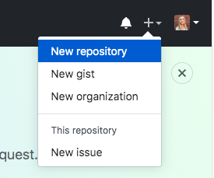
STEP 2
Partner A:
Go to GitHub Enterprise
Click on the + icon at the top right corner of the screen and select new repository

Slide 5
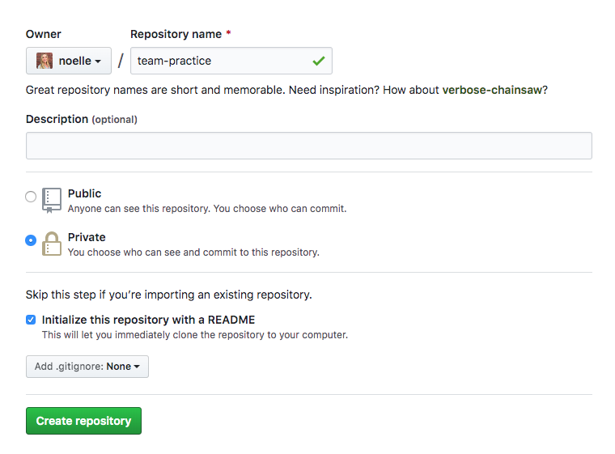
STEP 3
Partner A:
Name your repo ‘team-practice’
Check initialize your repo with a readme
Create your repo!

Slide 6
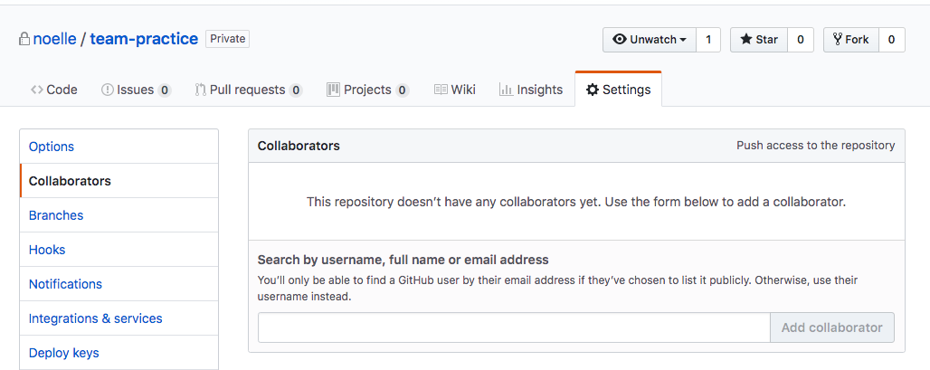
STEP 4
Partner A:
In your new repo, go to Settings -> Collaborators (you may have to type in your password at this step)
Add Partner B as a collaborator using their GitHub username
Slack Partner B the link to your repo. They should now have access!

Slide 7
STEP 4B
Partner A:
In your repo, go to Settings -> Collaborators (you may have to type in your password at this step)
Add your instructor (@hovanes/charles-rice) as a collaborator as well (so they have access to your work after you are done!)

Slide 8
STEP 5
Partner B:
Open up the repo using the link Partner A sent you.
Question: Has Partner B been added to the repo?
Notes:
🍐 This is a Pear Deck Multiple Choice Slide. Your current options are: A: Yes, Partner B has been added to the repo!, B: No, and I will reach out to my instructor for help with this step.,
🍐 To edit the type of question or choices, go back to the "Ask Students a Question" in the Pear Deck sidebar.

Slide 9
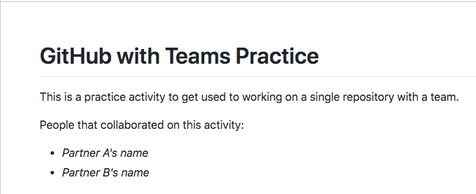
STEP 5B
Partner B:
Edit the README to look like this one:

Slide 10
STEP 6
Partner A:
Clone the repository to your computer
Navigate into the folder you want this to be located on your local computer
cd path/to/clone
Clone the repo
git clone <copied_clone_path_from_github>
Navigate into the cloned repo
cd team-practice

Slide 11
STEP 7
Partner A:
Add the Models.ipynb and data/admissions.csv files to the repo by copying it from your fork of materials into your new repo
cp ~/absolute/path/DSI/Week_07/hackathon/Models.ipynb .
(note: this is the copy command: cp from to - don’t forget the ‘.’ at the end to signify you are copying the notebook to this current folder)
Do the same for your data
cp ~/absolute/path/DSI/Week_07/hackathon/data/admissions.csv .

Slide 12
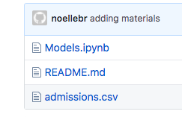
STEP 8
Partner A:
Add your changes
git add Models.ipynb
git add admissions.csv
Commit your changes
git commit -m “adding materials”
Push your changes
git push
Verify that your Models.ipynb and admissions.csv files are now on your GitHub repo

Slide 13
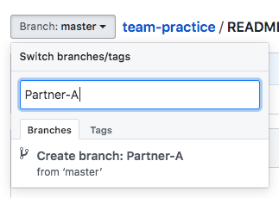
STEP 9A
Partner A:
Create a branch named Partner-A (or your name)
To do this:
Click on the Branch icon
Type the name of your new branch
Press enter
You should now be on your new branch

Slide 14
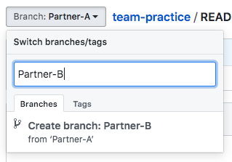
STEP 9B
Partner B:
Create a branch named Partner-B (or your name)
To do this:
Click on the Branch icon
Type the name of your new branch
Press enter
You should now be on your new branch

Slide 15
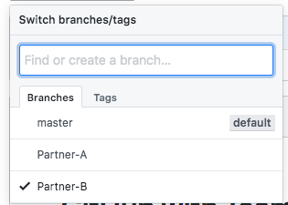
STEP 10
Both:
You should now have 3 branches:
Master
Partner-A
Partner-B
Verify that this is the case!
Question: Check your GitHub repo. How many branches does your repo have?
Notes:
🍐 This is a Pear Deck Number Slide
🍐 To edit the type of question, go back to the "Ask Students a Question" in the Pear Deck sidebar.

Slide 16
STEP 11A
Partner A:
Pull the new changes to your local repository
Navigate into your cloned repo
cd ~/path/team-practice
2. Pull the changes
git pull

Slide 17
STEP 11B
Partner B:
Clone the repository to your computer
Navigate into the folder you want this to be located on your local computer
cd path/to/clone
Clone the repo
git clone <copied_clone_path_from_github>
Navigate into the cloned repo
cd team-practice

Slide 18
STEP 12A
Partner A:
Change to your branch of the local repo
git checkout Partner-A
(you should see a message saying “Switched to a new branch ‘Partner-A’”)

Slide 19
STEP 12B
Partner B:
Change to your branch of the local repo
git checkout Partner-B
(you should see a message saying “Switched to a new branch ‘Partner-B’”)

Slide 20
STEP 13
Both:
Open up Jupyter notebook and work on your section of the Models.ipynb file
Question: Did you complete your section of the notebook?
Notes:
🍐 This is a Pear Deck Multiple Choice Slide. Your current options are: A: Yes!, B: No, and I will reach out to my instructor for help with this step.,
🍐 To edit the type of question or choices, go back to the "Ask Students a Question" in the Pear Deck sidebar.

Slide 21
STEP 14
Both:
When your section is complete, add, commit, and push your changes to your remote branch (before you do this, you can make sure you are working in your branch by typing git branch and checking that yours is starred)
Add your changes git add Models.ipynb
Commit your changes git commit -m “completed section”
Push your changes git push
Verify that your Models.ipynb and admissions.csv files are now on your branch of the GitHub remote repo

Slide 22
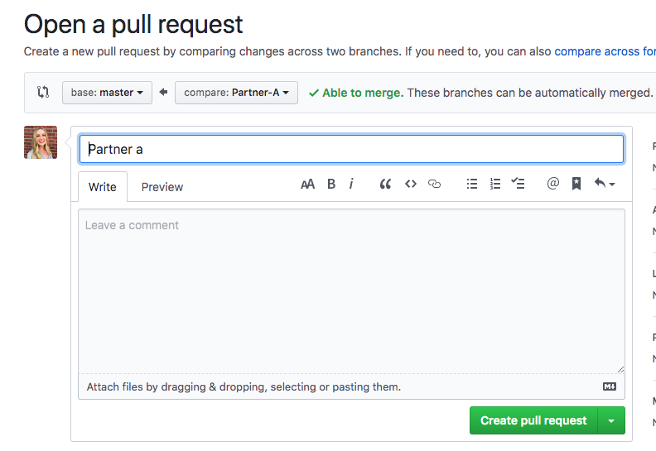
STEP 15A
Partner A:
Create a pull request to merge your material with the master branch on the remote repo.
To do this, click ‘New Pull Request’
The base should be the master branch
Create pull request, merge pull request, and confirm merge
You now should see your changes on the file on the master branch

Slide 23
STEP 15B
Partner B:
Create a pull request to merge your material with the master branch on the remote repo.
To do this, click ‘New Pull Request’
The base should be the master branch
Create pull request, merge pull request, and confirm merge
You now should see your changes on the file on the master branch

Slide 24
Merge Check
Question: Were you able to create and merge your pull requests?
Notes:
🍐 This is a Pear Deck Multiple Choice Slide. Your current options are: A: Yes, the master branch is up to date with my changes!, B: No, and I will read the next slide to see what I can do to fix my error.,
🍐 To edit the type of question or choices, go back to the "Ask Students a Question" in the Pear Deck sidebar.

Slide 25

Unable to Merge?
Were you unable to merge? It could be because:
You and your partner changed on the same line of code. To fix this, you must resolve the conflict before you can merge your pull request. Read more about that here: https://help.github.com/en/github/collaborating-with-issues-and-pull-requests/about-merge-conflicts
And see more about how resolve the merge conflicts in GitHub here: https://rollout.io/blog/resolve-github-merge-conflicts/
Or here (using the command line): https://www.cloudways.com/blog/manage-branches-and-resolve-conflicts-git/

Slide 26
Step 16
Both:
Once your master branch is up to date with both of your partners changes, submit the link to your repo here! (The master branch is where all of the final files should be - this is where everyone else will look to see your work)
Question: Paste the link to your GitHub repo!
Notes:
🍐 This is a Pear Deck Text Slide
🍐 To edit the type of question, go back to the "Ask Students a Question" in the Pear Deck sidebar.

Slide 27
More/Takeaways
Using GitHub is an easy way to keep track of changes and work on projects with others
You are not just limited to working on the same file as someone else; you can work on different files and push them to the master branch once you are done with your files
Branches are good ways to try things out before putting your code into production (the master branch is assumed to be the branch that will be used for production)
It is a good rule-of-thumb to never work off of the master branch when you are working with others

Slide 28
CONCLUSION
Let’s review our learning objectives:
Use GitHub as a resource for working on Data Science projects with teams
Question: What is one way that you can use GitHub as a resource when working on Data Science projects with others?
Notes:
🍐 This is a Pear Deck Text Slide
🍐 To edit the type of question, go back to the "Ask Students a Question" in the Pear Deck sidebar.

Slide 29
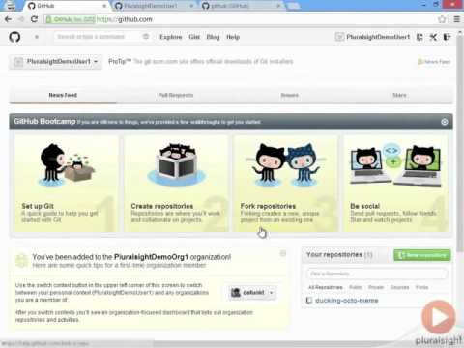
Bonus
Want to see even more on this topic? Watch this video: https://www.youtube.com/watch?v=y3AuydEpEgk

